Slide 1

Webinar for Aluminum Producers:
Understanding the USITC’s Greenhouse Gas Emissions Intensity Questionnaire
Greenhouse Gas Emissions Intensities of the U.S. Steel and Aluminum Industries at the Product Level (Investigation No. 332-598)
April 26, 2024
Caroline Peters (project lead); Kristin Smyth (deputy project leader, aluminum lead)
sa.emissions@usitc.gov
Notes:
Welcome to this webinar for aluminum producers on the U.S. International Trade Commission’s GHG Emissions Intensity Questionnaire. This questionnaire is associated with the U.S. International Trade Commission’s ongoing factfinding investigation 332-598: Greenhouse Gas Emissions Intensities of the U.S. Steel and Aluminum Industries at the Product Level. My name is Caroline Peters. I am an economist here in the Office of Industries and Competitiveness Analysis at the U.S. International Trade Commission, and I am leading this investigation. My colleague Kristin Smyth will also be presenting today – she also an economist in the Office of Industries and Competitiveness Analysis and is a deputy project leader and the lead on the aluminum portions of this investigation.
This webinar is a public event, but as the event title suggests, our comments today will be directed towards companies that are required to complete the questionnaire as determined by the products produced at their U.S. facilities in 2022.
The topical focus of the webinar today is understanding the motivation behind the greenhouse gas emissions intensity questionnaire, as well as its contents. We will be looking at sections in the facility-level questionnaire directed to facilities producing covered aluminum products in particular. Kristin and I are joined today on the call by our colleagues who wrote and programmed the questionnaire, so we welcome you to raise any issues you are having either in understanding the content of the questions or in navigating the electronic survey itself.

Slide 2
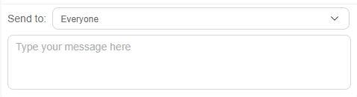

Before we begin
We’ll be addressing questions at the end of the presentation portion. When you have a question, please leave your questions in the meeting chat. We will address questions in the order received.
If you are having issues using the chat function or have more complicated or more specific questions that are better discussed orally, please call the project team after the webinar concludes at 202-708-0230 or email the team at sa.emissions@usitc.gov to schedule a time for a longer conversation
Notes:
Within this webinar, the presenters, aided by the project team members on the call, will be attempting to address your questions – we have dedicated over an hour in this two-hour block for this purpose. We ask that you please leave your questions in the meeting chat. You can open the chat in WebEx by clicking on the icon shown in the bottom right corner of your screen – please make sure your questions are directed to everyone so that all webinar attendees can read your query. We will address questions in the order received, and will be addressing questions at the end of the presentation portion of the webinar.
If we’re not able to address any questions in the time allotted or aren’t able to provide an immediate comprehensive answer, we will do our best to follow up after the event, either with the question asker personally and/or in updates to our FAQs document available on our investigation webpage.
Finally, if you are having issues using the chat function or have more complicated or more specific questions that are better discussed orally, please contact the project team after the webinar concludes for follow-up. The slides from this webinar will be posted to the investigation webpage later this week, so you will be able to refer back to them as reference.

Slide 3
Agenda
Background on the USITC and the survey
USITC’s approach to data collection and analysis for this investigation
Tips for accessing, navigating, and completing the questionnaire
Understanding terminology and how this questionnaire applies to my firm
Content of the facility-level questionnaire
Example questionnaire structure for different types of firms
Other resources for completing the questionnaire
Q & A

Slide 4
What is the U.S. International Trade Commission
Independent, nonpartisan, quasi-judicial federal agency with mandates to
  Conduct import-injury investigations (AD/CVD, safeguard)
  Maintain the Harmonized Tariff Schedule
  Section 337 unfair import investigations
  Prepare factfinding investigations at the request of Congress and U.S. Trade Representative (USTR)
Technical staff of industry analysts, economists, statisticians, attorneys
Does not provide policy recommendations as part of factfinding investigations
Regularly collects data from companies as part of many types of investigations, including this factfinding investigation
  Longstanding procedures in place to protect confidential business information (CBI)
Notes:
The U.S. International Trade Commission, or USITC or Commission, as we’ll call it throughout this presentation is an independent, nonpartisan, quasi-judicial federal agency with mandates in 4 different work areas. It conducts import-injury investigations such as antidumping and countervailing duty and safeguard investigations; it maintains the Harmonized Tariff Schedule which is a list of the tariff rates and statistical categories for all merchandise imports into the United States; it conducts unfair import investigations dealing with intellectual property rights and imports; and it prepares factfinding investigations at the request of Congress and USTR. This last mandate is what has prompted the investigation we are covering today, as we’ll discuss in the next slide.
The Commission is comprised of a technical staff of industry analysts, economists, statisticians, attorneys. In its factfinding investigations, the Commission does not provide policy recommendations. The Commission regularly collects data from companies in all types of the investigations it undertakes, and as such, has longstanding procedures in place to protect the confidential business information of firms.

Slide 5
Why is the USITC doing this survey?
Received request letter from USTR in June 2023, report to be delivered January 2025
PURPOSE: to inform USTR discussions on the Global Arrangement on Sustainable Steel and Aluminum
WHAT:
  Assess GHG emissions intensity (metric tons of CO₂e per metric ton of product produced) of covered steel and aluminum products produced in United States in 2022
  Describe methodologies used to collect information and analyze product-specific emissions intensities
  Identify locations (e.g., originating country) and production stages at which emissions occur
HOW: conduct a survey of firms, to the extent data is not already available from EPA’s Greenhouse Gas Reporting Program (GHGRP) or other public sources
PRESENTATION:
  Report estimates of the national average and a measure of the highest GHG emissions intensity by product category
  Public report will not contain any CBI or national security information (NSI)
Notes:
The USITC is conducting this survey we are discussing today as part of a request it received from the U.S. Trade Representative for a factfinding investigation. The investigation was requested last summer and will culminate in the submission of a report to the USTR in January 2025, with a release to the public of the report no more than 30 days afterwards.
In her letter, the USTR requests this investigation to inform ongoing discussions between the US and EU on the Global Arrangement on Sustainable Steel and Aluminum, which is contemplating new trade policy related the level of GHG emissions associated with traded steel and aluminum goods. The USITC is requested to
- Assess GHG emissions intensity (metric tons of CO₂e per metric ton of product produced) of covered steel and aluminum products produced in United States in 2022 (I’ll note here that the list of covered aluminum products is specified in the USTR’s request and also linked to separately in slide above. It will be explained by Kristin in greater detail later in this presentation.)
- Describe methodologies used to collect information and analyze product-specific emissions intensities
- Identify locations (i.e., originating country) and production stages at which emissions occur
To undertake the above research, the USTR requests that the Commission conduct a survey of firms to collect pertinent data, to the extent such data is not already available from EPA’s Greenhouse Gas Reporting Program or other public sources.
And finally, in the USITC’s report, the USTR requests that the Commission report estimates of the national average and a measure of the highest GHG emissions intensity by product category. The letter from USTR also specifies that the public report should not contain any CBI or national security information – consistent with this, we want to note that the both the average and measure of the highest product-level emissions intensity that the Commission ultimately presents will not identify any individual company or facility.

Slide 6
The importance of your mandatory questionnaire response
…to inform environmental trade policy
  Need national GHG emissions intensity estimates for trade policy
    Not all firms do GHG emissions accounting
    Those that do may use slightly different methodologies
  Have to collect data directly to have consistent estimates across different companies
…to ensure firms like yours are considered
  Helps policymakers understand the range of producers impacted by product-level actions
…to contribute to the development of GHG emissions accounting methodologies
  Understanding data availability may inform other efforts to do similar data collection
Notes:
If your firm produced the products covered under this investigation, your response to the USITC’s questionnaire is mandatory under part 19 of the U.S. Code section 1333(a).
Beyond your legal obligation to report, however, there are several reasons why it is important for you to respond to the questionnaire. First, your questionnaire response will help decisionmakers assess policy that supports the competitiveness of traded goods with lower embedded emissions. Policies like the EU’s Carbon Border Adjustment Mechanism have already gone into effect and other similar policies are being considered in the United States and other markets. The impact of these policies can’t be evaluated correctly if one industry or market is measuring greenhouse emissions differently than another, and as many of you know, there are already several different measurement approaches to choose from across various industry standards and frameworks. These different approaches do not always produce similar results when they are measuring the same process or facility because of the aspects of the value chain they include or exclude from the calculation or because of the different underlying data they rely upon. By contributing your response to this national data collection, you are helping the USITC produce a measurement of the embedded greenhouse gas emissions in U.S. steel and aluminum products that is generated from a single, consistent methodology and dataset.
Second, your specific response to this data collection helps ensure that that evaluation of policies includes consideration of your facility and facilities like yours. The U.S. steel and aluminum industries are comprised of companies and facilities of varying operations, capacities, and interests, from smelters and rolling mills with hundreds of employees, to casting facilities with fewer than 20 people on staff. Differences in these aspects across the various segments of the U.S. industry can be hidden or unaccounted for if information is only gathered from the largest producers or from producers who are most advanced in their own GHG emissions accounting. The USITC is relying on questionnaire responses to gather data that reflects all U.S. market segments so that it can generate emissions intensity estimates that represent the full range of firms that produce covered products -we’ll show how these responses will contribute to this effort a few slides from now.
Finally, because this data collection is one of the first of its kind conducted at this scale and scope by a U.S. government agency, lessons learned here on the ability of firms to report the data being requested will generate best practices if other efforts are undertaken in the future, in or outside of government. The content of your questionnaire response, both in the values you input as well as the narrative responses you provide, will aid in the development of these best practices.

Slide 7
Survey logistics
USITC
Due June 8, 2024
Facility 1 token
Your Company
Facility 1 (F1) that produces covered products
Facility 2 (F2) that produces covered products
Facility 3 (F3) that produces covered products
F1 Facility-level Q response
Due April 22, 2024
Company token
Company-level Q response
Facility 2 token
F2 Facility-level Q response
Facility 3 token
F3 Facility-level Q response
Questionnaire links also available at www.usitc.gov/saemissions
Notes:
This graphic explains the USITC’s data collection process for this survey. The survey data collection involves two questionnaires: the company-level questionnaire and the facility-level questionnaire.
In the first part of data collection, the Commission sent out notification on April 8 in the mail and by email to companies that may produce covered products. This notification correspondence contains a unique 10-character token to access the company-level questionnaire. This questionnaire asks recipient firms to list the location and contact information for facilities they own that produced covered products in 2022.
The USITC project team has already prepopulated facilities for each company that receives a questionnaire in the company-level questionnaire. This list was based on desk research: if there are mistakes in the facility list, such as inclusion of duplicate names, please let us know or make a change within the questionnaire itself. A response to the company-level questionnaire was due April 22 – we appreciate the prompt responses from those of you who have submitted. If your company received notification correspondence late or has not received it at all but believe you should have, extensions on this company-level submission deadline can be arranged in consultation with the project team.
Shortly after submission of the company-level questionnaire response, your company should receive new facility-level tokens for each facility it has listed. These tokens will be emailed directly to the facility-level contact person listed in your company-level response. If you are a company that only operates one facility producing covered products, you must still complete both the company-level and facility-level questionnaire. The facility-level responses for all facilities producing covered products within your company are due by June 8, 2024.
Links to both the company-level and facility-level questionnaires are available on the investigation webpage.

Slide 8
Exemption requests
I’ve received a company-level token, but my company doesn’t produce any covered products
I’ve received a facility-level token, but my facility doesn’t produce any covered products
Respond “no” to question 1.1.1 with narrative clarification provided in question 1.1.7
OR
Contact the project team for further clarification and confirmation
Respond “none of the above” to question 1.2.1
OR
Contact the project team for further clarification and confirmation
You will receive email confirmation of your exemption if granted
Notes:
If your company does not produce covered products and has received notification correspondence for this questionnaire in error, you may indicate this in the company-level questionnaire response you submit in question 1.1.1 with narrative clarification provided in question 1.1.7, or you may contact the project team for further clarification and confirmation. Whichever mode you report this information, the project team will review your explanation and provide you email confirmation of your exemption if granted.
Similarly to the company-level response, if you believe the facility for which you are responding does not produce covered products, you may indicate this in the facility-level questionnaire response you submit in question 1.2.1, or you may contact the project team.

Slide 9
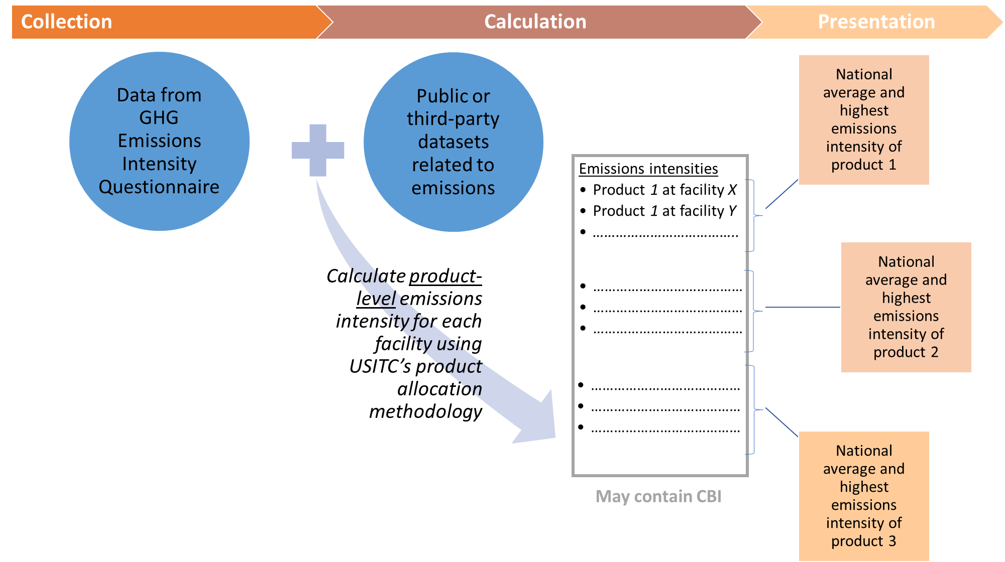
Analytical approach
Notes:
Now that we’ve reviewed our approach to data collection, we wanted to provide a peek behind the curtain of how the data you submit will contribute to the outputs presented in our final report.
The data from the questionnaire responses will be combined with other data sources like the EPA’s GHGRP to generate estimates of a facility’s production output and associated emissions. Then, employing a set methodology to allocate facility-level emissions to the different types of covered products produced within that facility, the USITC project team will generate emissions intensity estimates for each category of covered product produced at each reporting facility. As a last step, the USITC project team will take these granular facility-product category specific estimates, represented by the gray box above, and generate aggregate statistics for each product category. These aggregate statistics, representing the national average and some measure of the highest emissions intensity for each product category, will be presented in the final public report.

Slide 10
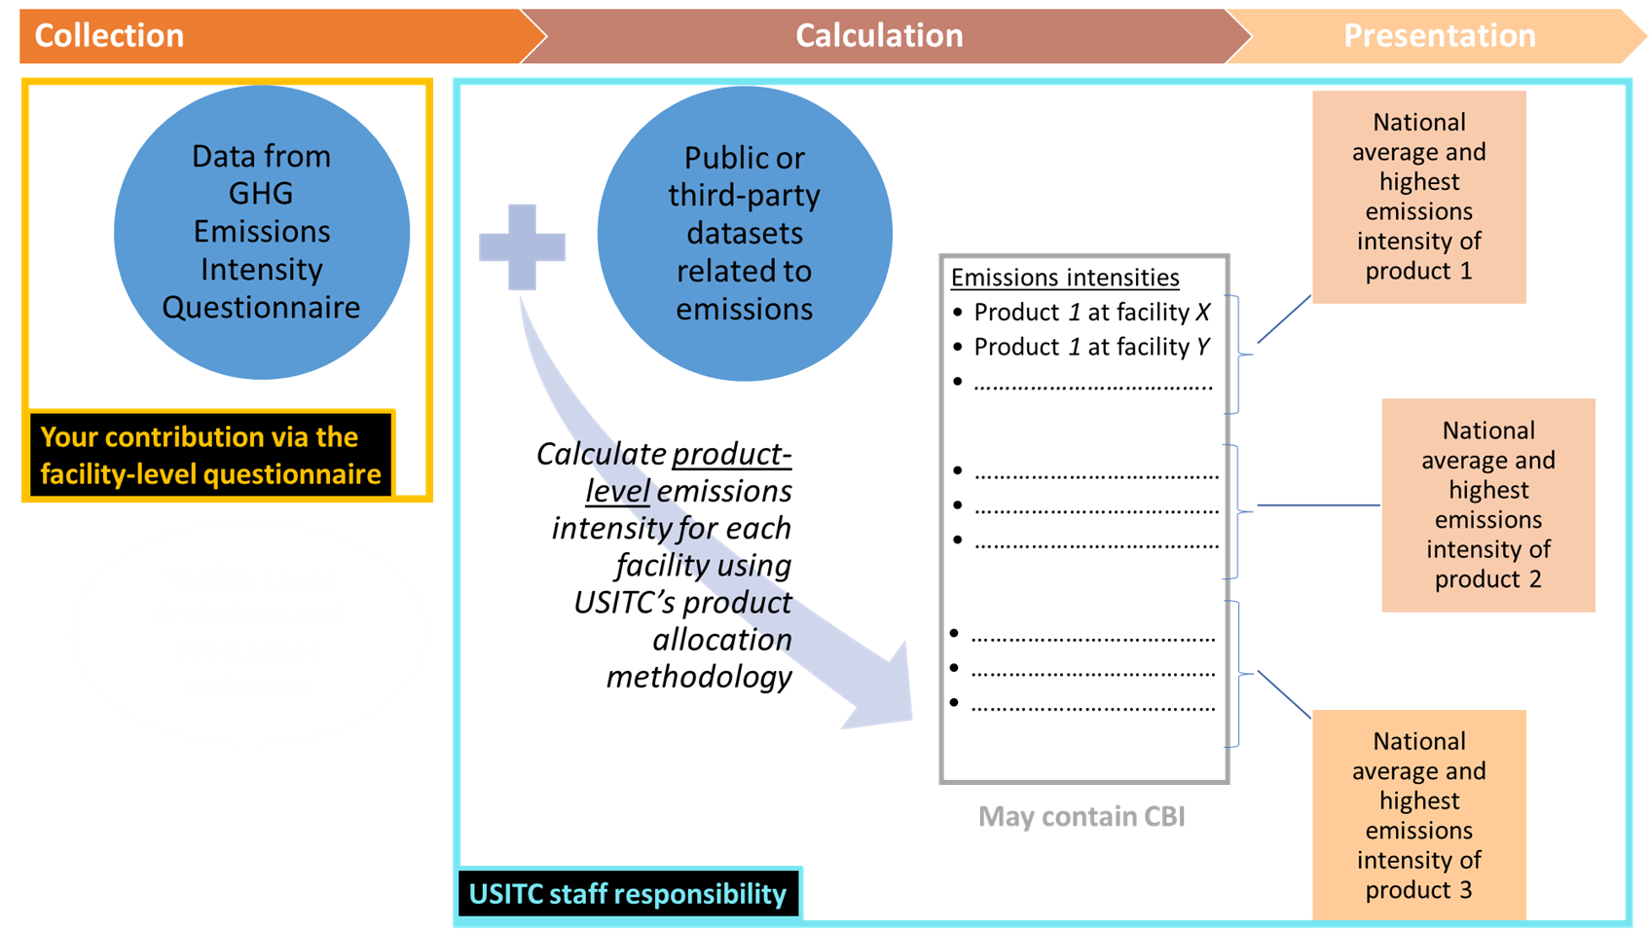
Analytical approach
Firms do not have to estimate their GHG emissions as part of survey, USITC will do that for them
Notes:
While generating emissions intensity estimates is a complicated process, we want to be clear that your contribution as a questionnaire respondent will only require you to provide the data on your facility’s production, energy use, and input use and sourcing in your facility-level questionnaire response.
Calculations to generate the levels of greenhouse gas emissions corresponding with the activities and materials that your facility reports will be performed by USITC staff, as will the further calculations to generate product-level emissions intensity estimates from questionnaire responses and other emissions-related data sources. Companies and facilities are not required to estimate their greenhouse gas emissions as part of the facility-level questionnaire – however, if responding firms wish to share greenhouse gas reporting they have generated internally for other purposes, such as EPDs or corporate sustainability reports, there is an opportunity to do so in section 7, as will be explained in greater detail later.

Slide 11






Emissions sources
GHG emissions
Emissions Source
At the facility
From energy usage
Embedded in inputs
Production output
Notes:
While this next set of diagrams may be very elementary some in this audience, they will help familiarize us all with the sources of emissions for which the facility-level questionnaire will be collecting data.
This investigation conceives of GHG emissions from three major sources.
First, emissions may occur onsite at the facility producing covered product. These emissions, called “scope 1” emissions in this investigation, may be associated with the chemical reactions occurring during the smelting process or with the fuel combusted in aluminum remelting and casting.
GHG emissions may also be released indirectly in relation to the production of a covered product. One such source for these emissions is the purchased electricity a facility receives. The emissions associated with electricity depend on the source of power generation for the electrical grid the facility is purchasing from. These emissions, related to the sourcing of purchased electricity by a facility, are called “scope 2” emissions in this investigation.
Finally, inputs into the production of aluminum covered products are also a source of GHG emissions this investigation is attempting to account for. These emissions may be associated with intermediate aluminum inputs, as well as with inputs such as alumina and carbon anodes which are incorporated further up the value chain. These emissions, embedded in material inputs into aluminum production, are called “scope 3” emissions in this investigation.
Before moving forward, we’d like to reiterate that the terms “scope 1, 2, 3” as we are using them in this investigation do *not* necessarily correspond to those employed by the GHG Protocol, which is the originator of these terms. In the GHG Protocol, these scope terms refer to reporting from the perspective of the corporate level – by contrast, reporting in this investigation request is from the facility-level perspective.

Slide 12

Emissions intensity calculation
(Metric tons of CO₂e)
(Metric tons of CO₂e per metric ton of output)
(Metric tons)
Production output quantity
Emissions intensity
Notes:
This slide provides a stylized illustration of the calculation USITC staff will undertake to generate emissions intensity estimates. Once measures of GHG emissions associated with onsite activities (scope 1), purchased electricity (scope 2), and material inputs into production (scope 3) have been calculated, the sum of these emissions will be divided by the total production quantities to generate an emission intensity estimate.
I’ll note that this is a very simplified diagram and does not show the more complicated steps the USITC staff will take to allocate facility level emissions to product-specific processes.

Slide 13









Emissions intensity, by product
Emissions intensity of semi-finished product (e.g., sows, ingots)
Emissions intensity of further finished product (e.g., pipe)
Notes:
We want to point out that the share of contribution to the total emissions burden from each emissions source is not consistent across the products covered under this investigation. For intermediate aluminum products, like sows and ingots, a larger share of overall emissions may come from scope 2 emissions rather than from emissions associated with onsite sources, as shown in the diagram on the left.
By contrast, the overall emissions burden of further finished products, like pipe, is likely to have a greater share of its associated emissions coming from the material inputs used in its production. Many firms have reached out to our team already, indicating that because they do not make aluminum, the amount of emissions associated with their production is negligible. This may be correct from the perspective of their scope 1 and 2 emissions, however, this investigation is collecting information on scope 1,2,3 emissions sources in the generation of product-level emissions intensity estimates. As such, it is still very important that producers of further finished products provide fulsome responses to the questionnaire in order for the team to produce complete emissions intensity estimates.

Slide 14
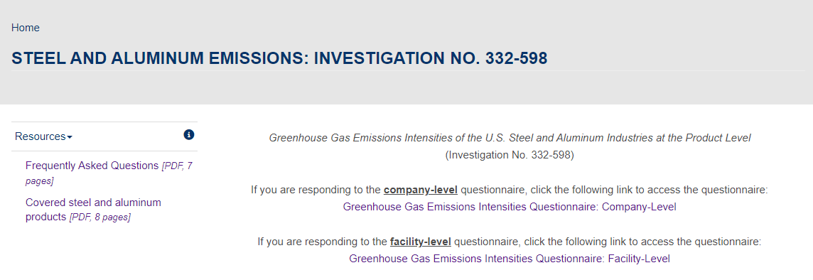
How do I access the questionnaire?
Email from USITCsurveys@usitc.gov will contain a link and 10-character token (“QXXXXXXXXX”) to access the questionnaire. A physical letter has also been sent with the company-level token
Also accessible via www.usitc.gov/saemissions
Notes:
Now that we’ve learned a bit about the data collection process and how the data will be used, we’d like to turn to the specifics of the questionnaire that will be employed to gather these data. The company- and facility-level questionnaires are electronic surveys. The links to these questionnaires are posted on the investigation webpage www.usitc.gov/saemissions, a screen cap of which is shown above. These questionnaires are accessible via a unique 10-character token, as was mentioned previously - these tokens are sent directly to company and facility-level contacts via email (and/or via physical letter, in the case of the company-level questionnaire).

Slide 15
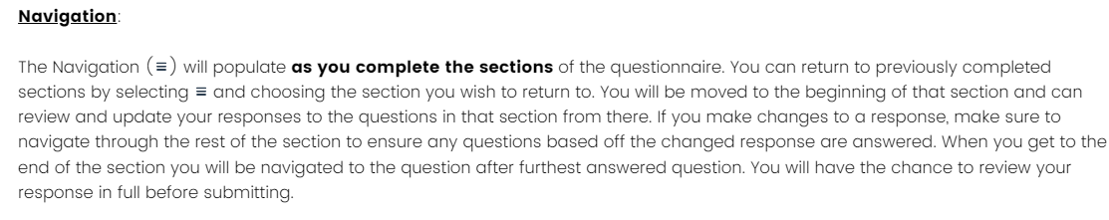
Navigating and entering your questionnaire response
Use the navigation pane to jump between sections
You will not see all sections if they don’t require information from you
Do not use your browser back button
Do use the back and next button within the survey
Notes:
Once you enter your token to log-on to the questionnaire, you will be able to advance through the questionnaire as you provide responses. The navigation pane, represented by the icon with three horizontal lines, will allow you to jump between sections of the questionnaire in which you have already entered responses. Sections in the navigation pane only appear once you have answered all the questions in that section which correspond to your facility’s operations. To navigate or page through a completed section, you can use the navy back and next buttons on the bottom of the page. Do not use your browser back and forward buttons for this purpose – doing so may take you out of your instance of the questionnaire, and may require you to reenter your token to continue.

Slide 16
Guiding principles and best practices for providing a questionnaire response
Provide best estimates where exact quantities are unknown
Gather the information you need (e.g., production levels, supplier information, energy use) from your knowledgeable staff before beginning response entry
  Reviewing the PDFs of questions in the questionnaire is helpful for this exercise
Review the glossary and identify the types of product categories your facility uses and produces based on the questionnaire definitions
Download a PDF of your questionnaire response after submitting
If you have questions, always feel free to ask the project team at sa.emissions@usitc.gov or 202-780-0230
Notes:
And finally, before we take you through the content of the facility-level questionnaire, we’d like to note some best practices that the USITC team has compiled as you enter responses.
First, we encourage you to provide your best estimates where exact quantities are unknown. We recognize that approximating of inputs, fuels, and electricity dedicated to the production of covered products may be very difficult to do, especially in facilities that produce multiple types of products, including some that may not be covered under this investigation. We only ask that you make your best guess in these situations, and use narrative responses when possible to spell out your logic.
Second, we also encourage you to gather the data inputs the questionnaire asks for before sitting down to enter them. Gathering these data may involve consulting multiple departments within your facility or company – as such, we suggest downloading the PDF of the questions the questionnaire asks, in order to have the full picture of data inputs your facility will need to provide in sections you have not arrived at yet.
We also recommend careful review of the glossary before your complete the questionnaire, especially the definitions of the types of products used and produced at your facility. Glossary definitions can also be accessed via hover text throughout the questionnaire for those terms that are orange and underlined.
Once you have completed the questionnaire, our team strongly encourages you to download a copy of the PDF of your responses after submitting (we will walk through how to do this at the end of the presentation).
And finally, please contact the project team with any questions and concerns as you go. The USITC’s subject matter experts and survey programmers who designed the questionnaire are all closely monitoring incoming correspondence, so you should be able to get a final answer to your inquiries promptly.

Slide 17
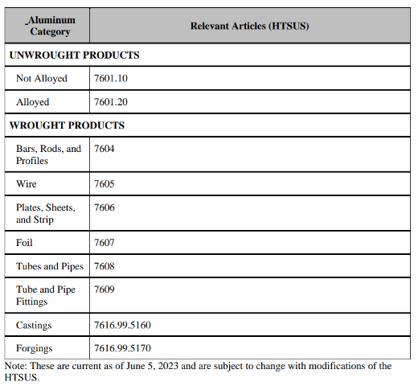
What kind of companies must complete this survey?
Notes:
If your company has facilities that produced covered steel and aluminum products at any point in the 2022 calendar year, then you are required to respond to the questionnaire.
“Covered products” include those that match the description provided in the covered product list or that correspond to the U.S. Harmonized Tariff Schedule subheadings that comprise the list. These include unwrought products either alloyed or not alloyed. The unwrought products in 7601 can include both primary and secondary material in forms like ingots, billets, and slabs.
It also includes what the Tariff Schedule calls “Wrought products.” The first of these is “bars, rods, and profiles,” which I would like to note is the category under which many aluminum extrusions fall. So I know the word extrusions isn’t there and that is throwing people off but most likely if you are making an extrusion, it falls under this category. Also wire, plates, sheets, and strip, foil, tubes and pipes, tube and pipe fittings, castings, and forgings.
“Production” includes the production of covered products even if those products are entirely consumed as intermediate inputs at the same facility they are produced (in the case of facilities that primarily manufacture finished products). More finished products, like many automotive parts, door frames, boat hulls, etc are not covered products
“Production” may also include certain processing/finishing steps such as:
Cold rolling (i.e., cold reducing) of aluminum
Cold drawing (e.g., wire drawing, drawing of other long products) of aluminum
Transformation of one form of secondary unwrought aluminum into another form of secondary unwrought aluminum, such as remelt scrap ingot made from dross into billet, so yes, dross processors are required to complete the survey

Slide 18
A note on terminology in the aluminum questionnaire
Aluminum, unwrought—ingots, slabs, blocks, billets, sows, etc., produced by casting molten aluminum of either primary or secondary origin, but not further machined or processed, other than by simple trimming, scalping, or descaling. Unwrought aluminum products are defined in this investigation as those corresponding to HTS heading 7601.
Aluminum, wrought—rolled, drawn, extruded, forged, or otherwise mechanically worked (formed) aluminum products. For the purposes of this questionnaire, this includes aluminum bars, rods, profiles, plates, sheets, strip, foil, wire, pipe, tube, pipe and tube fittings, castings (such as die castings or sand castings), and forgings.
Aluminum castings—the solid, rough, finished, or near-finished (near-net) aluminum shapes resulting from the foundry or die-casting processes. Aluminum castings covered by this investigation are those products corresponding to HTSUS statistical reporting number 7616.99.5160.
Notes:
Since our survey classifies products based on the Harmonized Tariff Schedule, we try to use definitions in the survey that align with those product definitions. We know that these are not always how all parts of the industry understands these terms and so it is important to understand how they are being used in our survey. For the purposes of our questionnaire we determine something to be wrought based on the level of processing/shaping it has gone through rather than whether or not it has been alloyed. In other words, if you are purchasing foundry alloys as inputs, and they have not been further worked via rolling, drawing, extruding, forging, or other mechicanical forming, we’d consider that an unwrought aluminum input. Whether that unwrought input is primary or secondary would depend on whether it was made directly from alumina or made from the remelting of scrap. We have seen a lot of early responses assuming these inputs are wrought because they are alloyed, but that is not how we define the terms for the purposes of this survey.
I know also that many aluminum casters refer to their product as an “unwrought product,” however our definition is that they are a wrought product - the solid, rough, finished, or near-finished (near-net) aluminum shapes resulting from the foundry or die-casting processes. Aluminum castings covered by this investigation are those products corresponding to HTSUS statistical reporting number 7616.99.5160.

Slide 19
What kind of questions does this survey ask?
Company-level questionnaire
Facility-level questionnaire
  Product types produced and units (section 1)
  U.S. production (section 2)
  Fuel combustion and energy allocation (section 3)
  Purchased energy (section 4)
  Uses and sources of production inputs (section 5)
  Questions related to process emissions (section 6 – can ignore, only for steel producers)
  Optional reporting of company- or facility-specific environmental data and emissions factors (section 7)
Identification of facilities that produced covered product in 2022
Address and contact information for those facilities
Firms are not required to estimate their GHG emissions as part of either questionnaire
Notes:
The Company level questionnaire is the first questionnaire sent to companies. The Commission has prepopulated in this portion of the survey the facilities that it believes the company is responsible for, but this was based on desk research and if there are mistakes, such as inclusion of duplicate names, please edit in the questionnaire or contact us and let us know. This portion also contains instructions for adding or removing facilities, adding appropriate facility contacts, how to deal with more complicated ownership arrangements – and you can feel free to email the survey team if you need help navigating this portion, although hopefully most of you on this call have completed this portion by now.
The next section of the presentation will go into each of the facility level questionnaire sections in more detail. As an overview, the survey asks for production type and amounts, fuel and energy use, production inputs, and there is an optional section for additional information. And all of this information is asked for only in relation to the year 2022. As a reminder, companies and facilities are not required to estimate their greenhouse gas emissions as part of either questionnaire.

Slide 20
Section 1 – Types of products
1.2.2 selects the method of production
1.2.3 selects the aluminum products you produce including breakouts for different types of wrought products
These questions will set up the skip logic that will tailor the rest of the questions you receive throughout.
Notes:
In Section 1 you select between being a primary unwrought, secondary unwrought, and/or wrought producer. Keep in mind our unwrought and wrought definitions provided earlier. Then 1.2.3 asks which products you produce, including the individual wrought products. The important point is that the answers you select here will set up what we call the “skip logic” for the rest of the questionnaire, meaning it will tell the survey which questions you need or need not see based on what you are making.

Slide 21
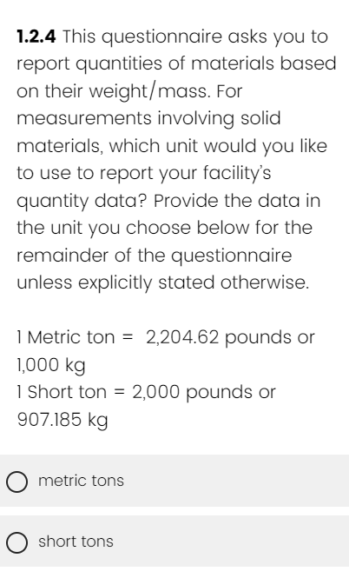
Section 1 – Units
The survey does not accept quantities of materials in pounds or kilograms, you must convert to either metric tons or short tons for the duration of the survey.
Notes:
Section 1 is also where you will select if you will report quantities of materials in metric tons or short tons. Pounds are not accepted so please be mindful of your conversions and use the factors provided here so we are all using one common standard.

Slide 22
Section 2 – U.S. Production
Production output quantity
Emissions intensity
Notes:
Moving to Section 2, I would like to take a moment to orient you between the data being collected here and why it is necessary for the emissions intensity calculation. This section collects information on the quantity of production, which will be the denominator that divides out the overall emissions from the relevant domain of facility/process/product.

Slide 23
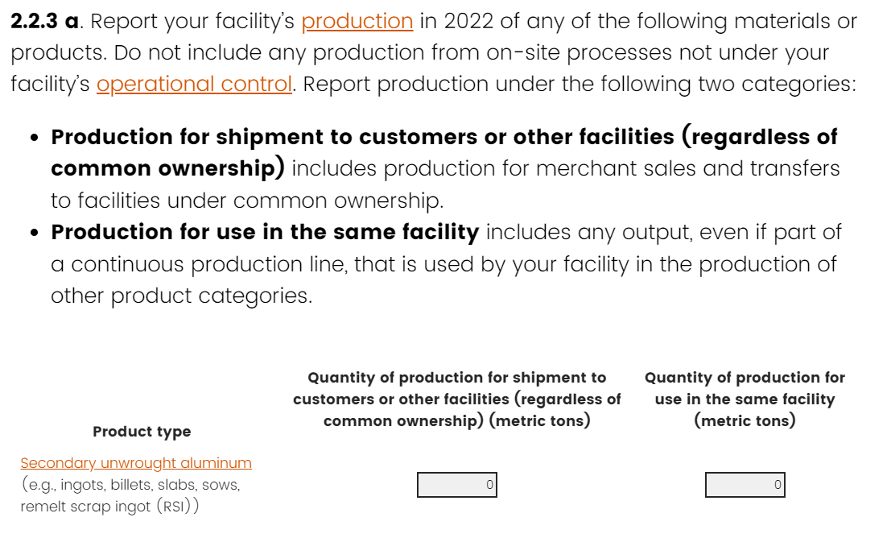
Section 2 – U.S. Production
Notes:
You may see some variation of this question depending on what you answered in Section 1. It asks you to report production but split between two categories- that for shipment to other facilities, and that for use in the same facility.
Production for shipment to other facilities includes production for merchant sales and transfers to facilities under common ownership. Please note that the questionnaire uses a relatively broad definition for what is external to the responding facility: other facilities owned by your company, activities that occur on-site for your facility but are operated by another entity, and off-site facilities under different ownership are all considered external.
Production can also be for Use in the same facility, that is, entirely consumed as intermediate inputs at the same facility they are produced.

Slide 24
Section 3 – Fuel Combustion and Energy
Allocation
Production output quantity
Emissions intensity
Notes:
We proceed now to Section 3, where we collect information on Fuel combustion and energy allocation, which forms part of the Scope 1 emissions from a facility.

Slide 25
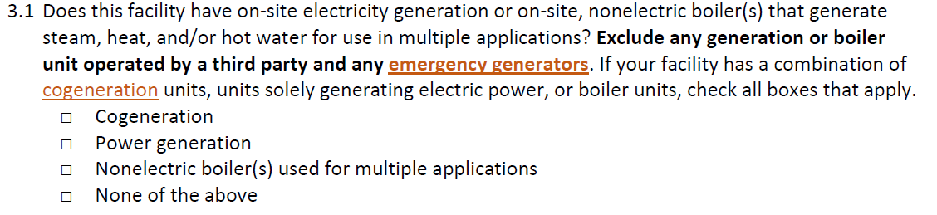
Section 3 – Fuel Combustion and Energy
Allocation
Please be mindful of units!
Notes:
First, a note - Be mindful of units in this section. We are not just talking about quantities of materials anymore. If the units are not labeled as being on a scale like thousands or millions, they should be reported in the actual amount, even if that means including many zeroes.
The section begins by asking about types of possible onsite energy generation – cogeneration, power generation, or nonelectric boilers. The skip logic will then take you to provide further details if you check off that you do have these features.
One thing that has tripped a couple firms up here is that we do not mean a boiler only used for space heating, you do not to report that here.

Slide 26
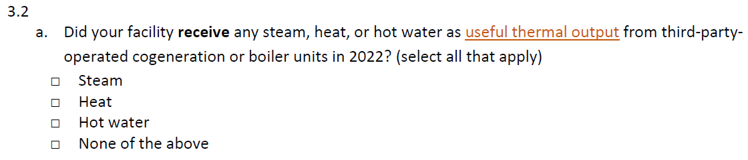
Section 3 – Fuel Combustion and Energy
Allocation
Notes:
An example of further details that might be asked for would be questions 3.2a and 3.3b which ask for information on any steam, heat, and/or hot water that produces useful thermal output from third-party operated cogeneration or boiler units and then asks you to report the quantities. Many facilities won’t have anything to report here. But any steam, heat, and/or hot water from external sources—including from on-site third-party operated cogeneration units—should be reported here. You’ll need to report similar information, but broken down by the different supplying plants, in question 4.7.

Slide 27
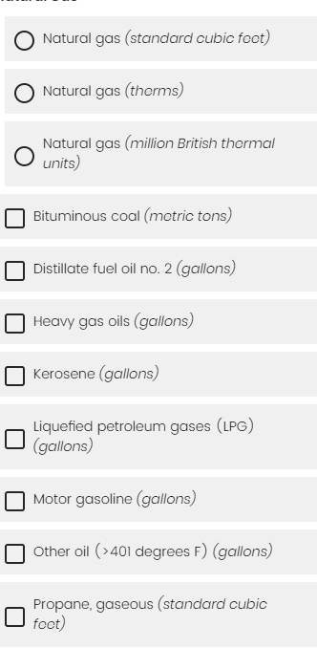
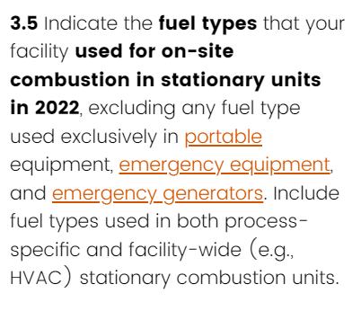
Section 3 – Fuel Combustion and Energy
Allocation
Notes:
Section 3 will also ask about fuel types and amounts used for on-site combustion in stationary units. Shown here is 3.5 which asks you to narrow down which fuels you use. If you accidentally click one of the three natural gas buttons there at the top, you can clear those again by checking “no onsite fuel combustion”. And then in…

Slide 28
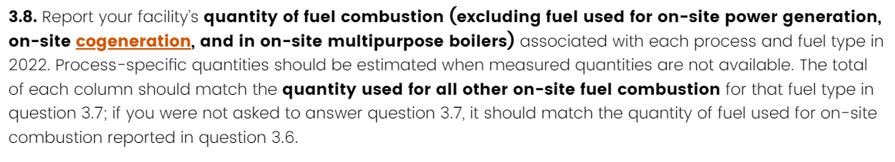

Section 3 – Fuel Combustion and Energy
Allocation
Notes:
… Question 3.6 it asks for quantities of these fuels. Depending on which situation applies to you, you will then get a series of questions asking to assign those quantities to certain processes. On this slide at the bottom, you see the option in rows of secondary unwrought aluminum and wrought aluminum, and in the columns, natural gas and kerosene. You would divide out the fuel by the process that it is used for.
You may have also reported in Section 1 that you produce non-covered products, and there is a row to assign fuel use to that process as well.
Please pay careful attention to the instructions in questions 3.7 through 3.9 to ensure that data reported in these questions totals to quantity data provided elsewhere in the questionnaire. Data in questions 3.7 and 3.8 are more granular breakdowns of data reported in 3.6 and sometimes 3.7; unless your facility has on-site generation that is not third-party operated, the data reported in 3.9 should total to your facility’s electricity purchases, which you will be asked for in question 4.1.

Slide 29
Section 4 – Purchased Energy
Production output quantity
Emissions intensity
Notes:
Moving right along we are already at Section 4, purchased energy, which is a part of Scope 2 emissions.

Slide 30
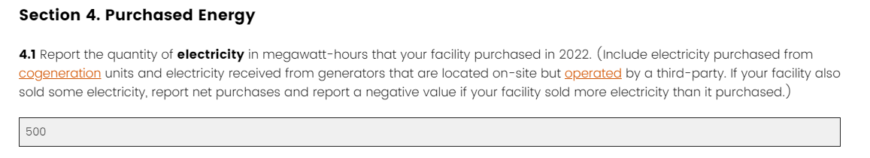
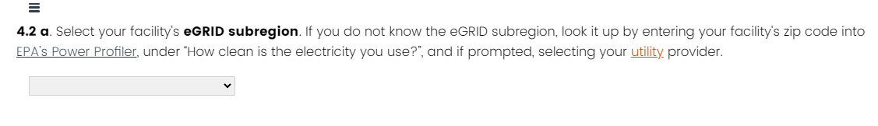
Section 4 – Purchased Energy
Notes:
We will start here with one that is relatively straight forward – quantity of purchased electricity and the eGRID subregion for your location, so the energy team has information on the fuel mix of the purchased electricity.

Slide 31
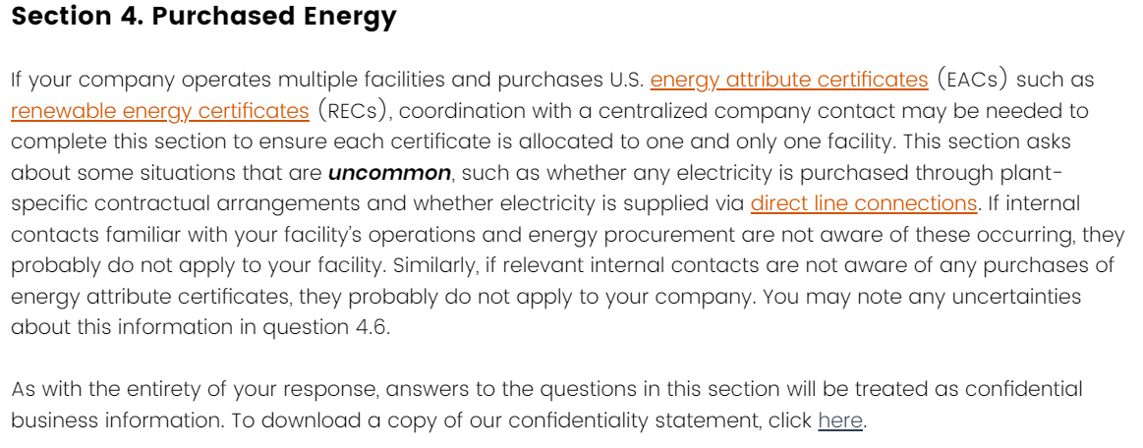
Section 4 – Purchased Energy
Notes:
This instruction, which I don’t want to read off the slide since you will have the pleasure of doing that yourself, will not apply to very many facilities. It imparts that facilities may need to coordinate with company-level contacts in order to provide information on purchased renewable energy certificates and that you can please leave any detailed comments on uncertainties about information in this section in text box in Question 4.6.

Slide 32
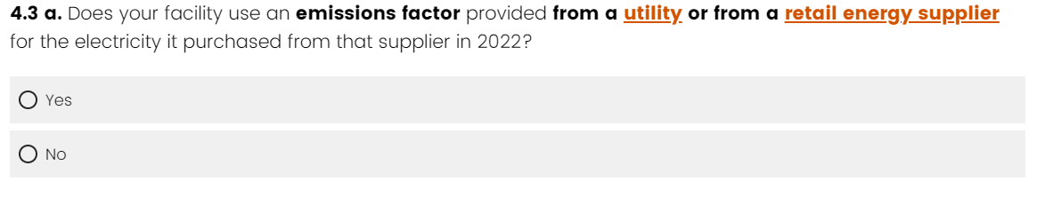
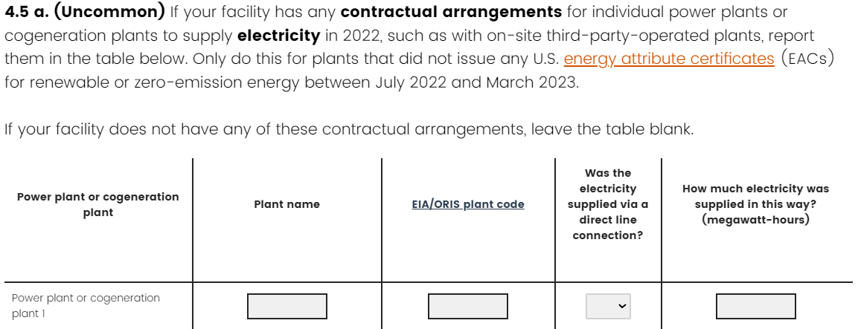
Section 4 – Purchased Energy (uncommon)
Notes:
There are some little tricky questions in Section 4, and here are some notes to help you along.
Question 4.3a: If your facility does not do greenhouse gas emissions accounting, you can answer ‘no’.
Question 4.5: This question is labeled uncommon but is relevant to facilities that source electricity from onsite, third-party operated power generation (including from combined heat and power generation).

Slide 33
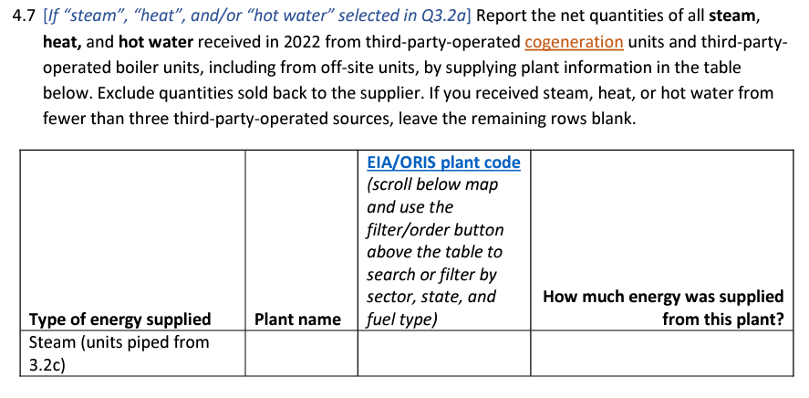
Section 4 – Purchased Energy (uncommon)
Notes:
And then-
Question 4.7: This, again, won’t apply to many facilities, but if you reported receiving any steam, heat, or hot water in section 3 you will need to list the specific plants you received this thermal energy from. If you received it from a boiler, please note that in the plant name; otherwise please determine the plant code for the cogeneration plant that supplied it. The plant-specific amounts you report here should total to the quantity received that you reported in section 3.

Slide 34
Section 5 – Uses and Sources of Production
Inputs
Production output quantity
Emissions intensity
Notes:
And this brings us to section 5, which is information on the inputs you are purchasing to create your products – what they are, how much of them there are, and where they came from. These are commonly referred to as Scope 3 emissions. This section also helps us to understand how your facility uses materials made externally and within the facility itself, which is key to our creation of product-level emissions that “roll up”—or aggregate—emissions associated with upstream materials.

Slide 35
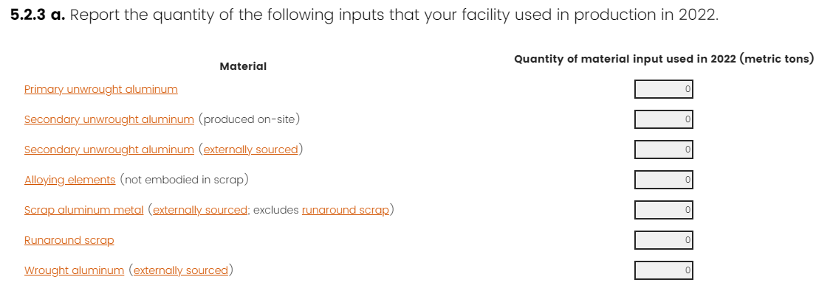
Section 5 – Uses and Sources of Production
Inputs
Notes:
The very first screen asks an overarching question that will then set up what you need to answer for the rest of the section. This question asks the quantity of these potential input materials used to make your products in 2022. The latter half of this section will ask for further details on where these inputs came from and let you allocate this total between multiple products, if you produce more than one. So the key here is to remember you will need to allocate from earlier questions in later questions. And remember, your version of this question in the questionnaire will depend on what you answered in Section 1 for what products you make. In this example we have (read materials on screen)
One note here is that we ask for runaround scrap merely as a way to try to help point out that this quantity does not belong in the other buckets, and if you do not know a precise amount for this, that is totally fine, put in an estimate and keep moving.

Slide 36
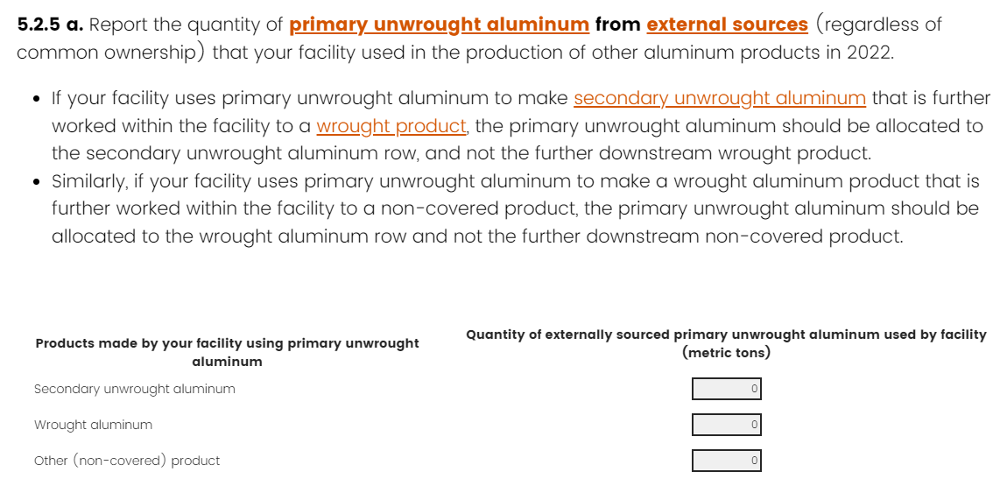
Section 5 – Uses and Sources of Production
Inputs
Notes:
This is an example of sorting that total amount of input from the first question into the relevant production buckets- here I checked that I make both a secondary unwrought aluminum product and a wrought aluminum product and it lets you allocate the primary aluminum by which product it is used for. I show the primary unwrought aluminum question as the example because, as you can imagine, this is the question where the more detail and the more accuracy you can provide, it can make a big difference in how accurate our final emissions are. Primary aluminum is responsible for a majority of aluminum product emissions, and so capturing if your primary aluminum comes from a hydro-powered smelter in Iceland or from a coal powered smelter in China makes a big difference to the emissions calculations.

Slide 37
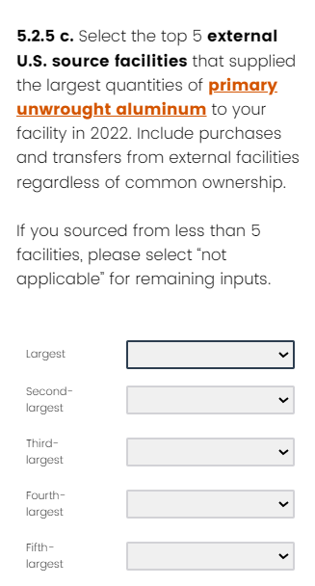
Section 5 – Uses and Sources of Production
Inputs
Notes:
If you mark that an input came from a domestic source, it should have been produced in the U.S. Using a domestic trader to source international aluminum should not be reported as coming from a U.S. source. In the case of primary aluminum, you have the option of selecting the specific smelter that the metal came from, which helps us get a more accurate accounting of the upstream emissions. If the primary metal was smelted in a foreign location, we have an option to list what specific country it comes from for a similar reason.
This also goes for questions about secondary aluminum, where we ask where the primary aluminum material contained in the secondary aluminum was smelted. We also know not all firms may be able to gather this information, but just ask that you put in your best estimate.

Slide 38
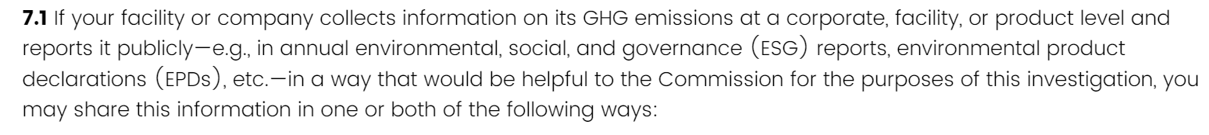

Section 7 – Other Information (OPTIONAL)
Notes:
Lastly, section 7 provides respondents an opportunity to upload supplementary materials regarding their own internal GHG emissions accounting efforts, such as EPDs and ESG reports, in question 7.1, and to explain any of the responses they have entered elsewhere in the questionnaire in question 7.3. For question 7.1, you will be asked to provide a single combined pdf upload of any supplementary materials.

Slide 39
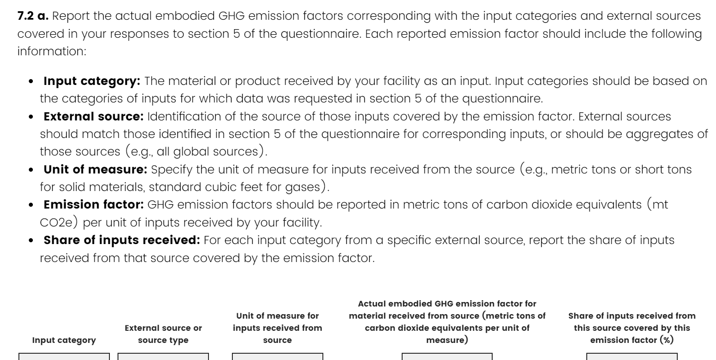
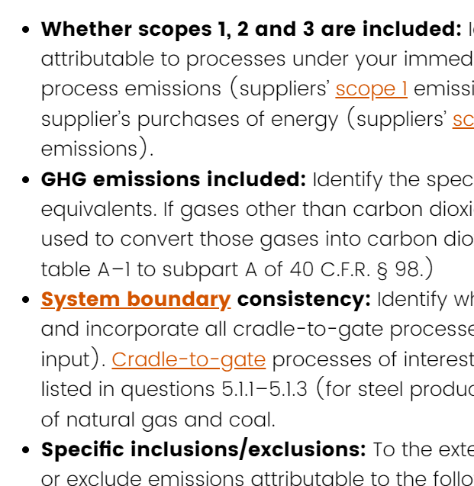
Section 7 – Other Information (OPTIONAL)
Notes:
If your company already performs carbon accounting and you have emissions factors for your input materials, you can upload them in a PDF attachment in Section 7. We may use this data to compare how using this information changes the results from our standard methodology. The document should contain as much detail about the relevant system boundaries and other pertinent information, as shown here.

Slide 40
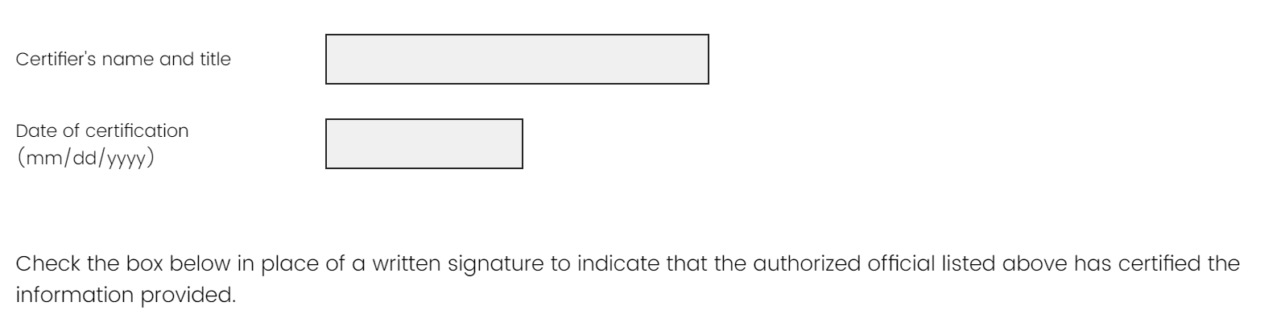
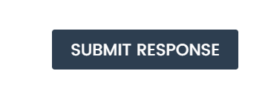
Submitting your questionnaire response
Certify your questionnaire response in section 8
After reviewing your response using the navigation links, menu and back button, click the submit button at the end of the review page
Notes:
In order to submit a facility-level questionnaire, you must first certify your response in section 8. After that, the last page of the questionnaire is a navigation page with links back to specific sections you’ve completed so that you can review all of the answers you input into the survey. Once you have reviewed your responses one last time, select the “submit response” button at the end of the page. You MUST still click this button for the final submission of the questionnaire. It can look like you are done before you do this if you are not paying close attention.

Slide 41

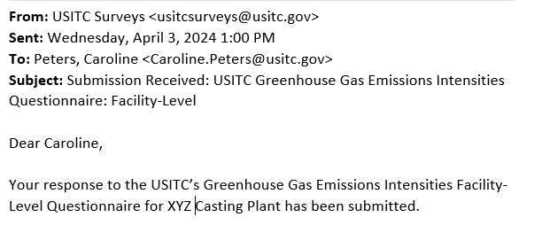
After submitting your questionnaire response
Click the Download a PDF link on the page following the “submit response” button (highly recommended)
Check for a confirmation
email from the project team
3. Look out for follow-up correspondence from individual members of the project team if clarification on your response is needed
Notes:
After hitting the “submit response” button, you will be taken to a page that displays all the questionnaire responses you just submitted on behalf of your facility. Before leaving the browser window, click the “download pdf” link close to the top right of the page – this will produce a nicely formatted document of your response for your recordkeeping. Soon after your questionnaire submission is transmitted, you will receive a confirmation email with the subject line “Submission Received,” as shown in the slide. You may also wish to save this for your records. In the days and weeks following your submission, members of the project team may reach out to you for clarification on parts of your response – we want to be sure your efforts to complete this questionnaire result in the most accurate, highest quality data reporting possible, so we appreciate your patience as our team works to understand and verify your responses.

Slide 42


Example survey structure: facility producing aluminum sand castings
Inputs and linked processes
Section 5 (Scope 3): 5.2.3 Quantity of Primary unwrought aluminum used in production; 5.2.5 Breakdown of those purchases by domestic and international suppliers
Primary unwrought aluminum
Sections 3+4 (Scopes 1+2): 3.5 and 3.6 Fuel use; 3.8 attribute fuel use to process “Wrought aluminum”; 3.9 Electricity use attributed to process “Wrought aluminum”; 4.1 Purchased electricity; 4.2 eGRID subregion
Facility
processes
Molten aluminum
Furnace
Caster
Section 2 (Production): 2.2.3 Quantity of castings produced
Facility
shipments
Wrought aluminum casting
Notes:
Here we have an example
Facility makes aluminum castings

Slide 43
Other resources for completing the survey
The list of steel and aluminum products covered under this investigation
PDF downloads of all questions asked company- and facility-level questionnaires
  Company-level
  Facility-level – Aluminum and Steel combined
  Facility-level – Aluminum only
  Facility-level – Steel only
A list of FAQs about this data collection, continually updated throughout this investigation
See our investigation webpage www.usitc.gov/saemissions for more background information on this study request
Notes:
To wrap up the presentation portion of this webinar, we wanted to highlight some resources that may be useful as you prepare your facility’s questionnaire response. In addition to the list of covered products and PDFs of the questions within the questionnaire, the project team has prepared an FAQ document to address some common concerns respondents may have. This FAQ document is continuously updated based on the feedback we receive from respondents, including questions and concerns you express during the upcoming Q&A portion of this webinar.
All of these resources are hosted on our investigation webpage www.usitc.gov/saemissions.

Slide 44
Contacting the project team
Please contact the team if you have questions, especially if
  You think your company produces covered products in the United States, but you have not received a token to complete the questionnaire
  You’ve gotten stuck or locked out of your questionnaire response
  You need clarification on what the questions are asking
sa.emissions@usitc.gov or 202-780-0230
Notes:
As has been reiterated many times throughout this presentation – please contact the USITC project team if you have any concerns during this data collection. We should be able to get you a resolution to your query, whether it is a question about the applicability of the survey to your company, a question on token access, or a question clarifying terminology within the survey.

Slide 45
Questions?

Slide 46
Thank you for joining us! This presentation has now concluded.
Please visit our website at https://www.usitc.gov/saemissions or contact the project team at sa.emissions@usitc.gov or
202-780-0230 with any additional questions.

